Slide 1
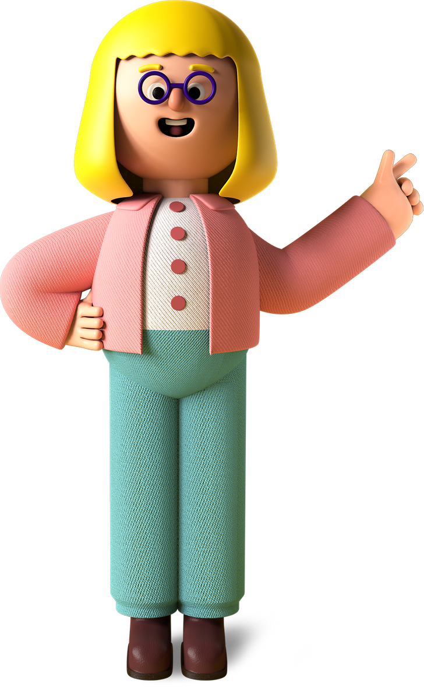
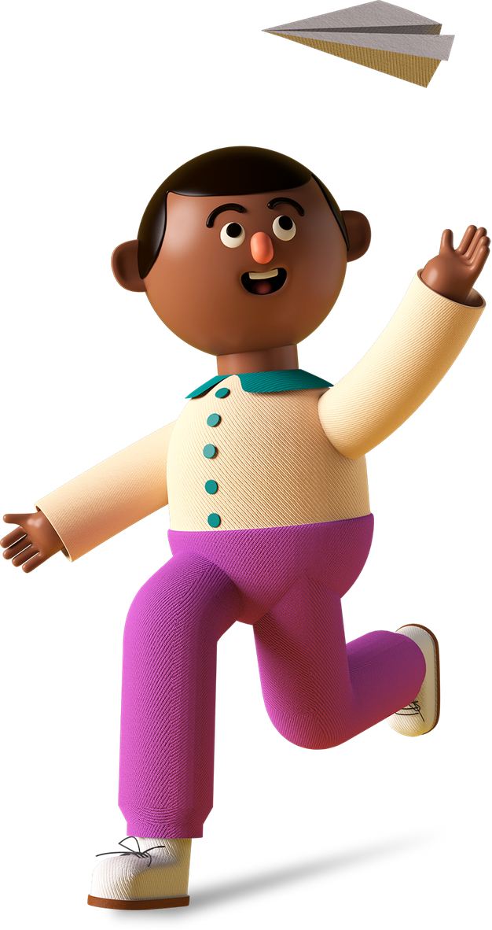
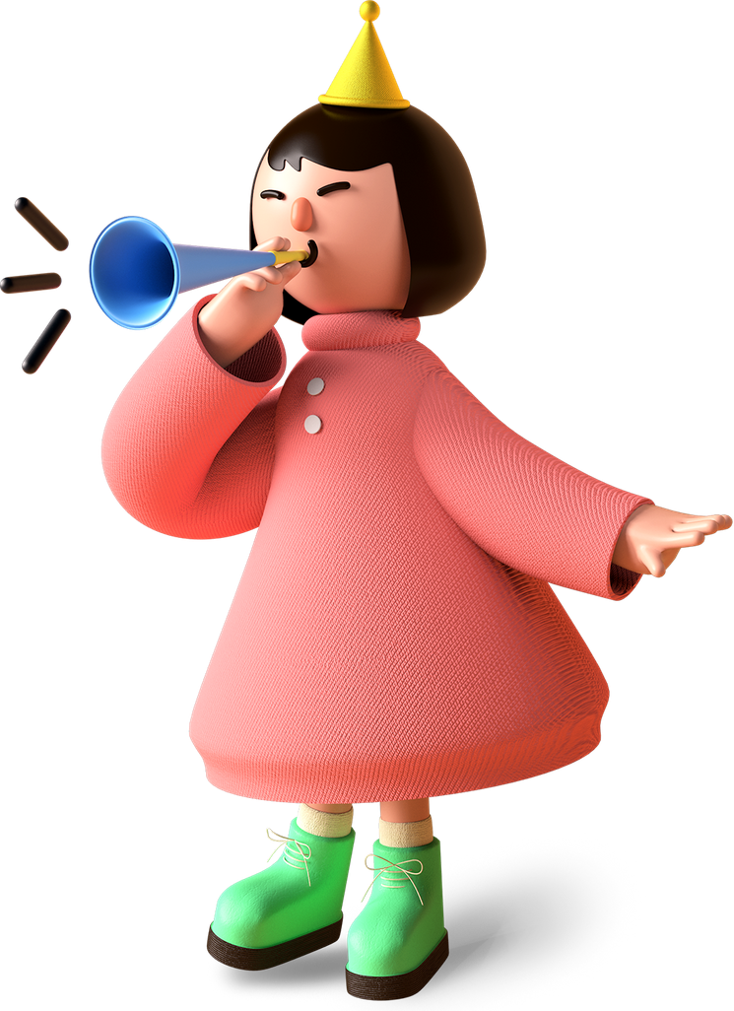
Student
Project

Slide 2

Project Name
Ninja fruit game

Slide 3
Project Link
https://editor.p5js.org/Irawhj/present/0RlUloYfr

Slide 4
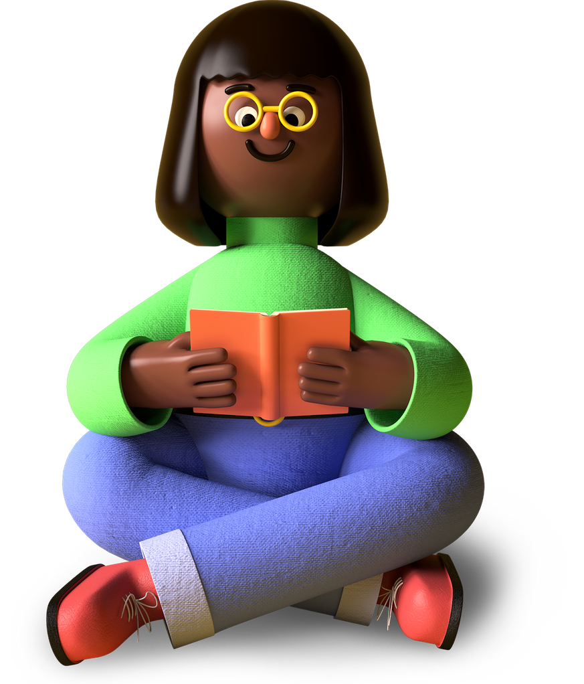
My favorite part about the project
My favourite part in the project is making animations

Slide 5
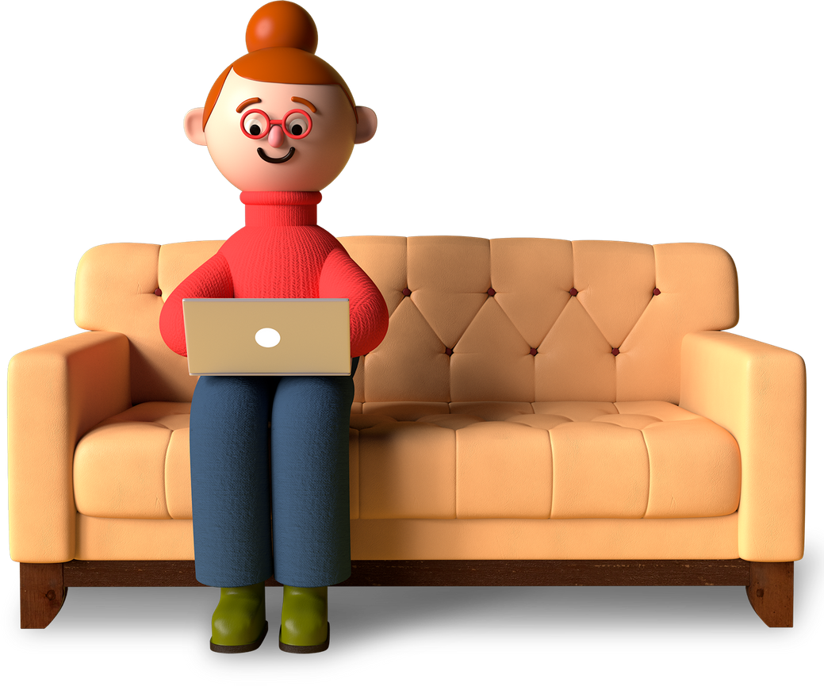
What I learned from it
01
To apply images
02
Mouse controls
03
To show the score board

Slide 6
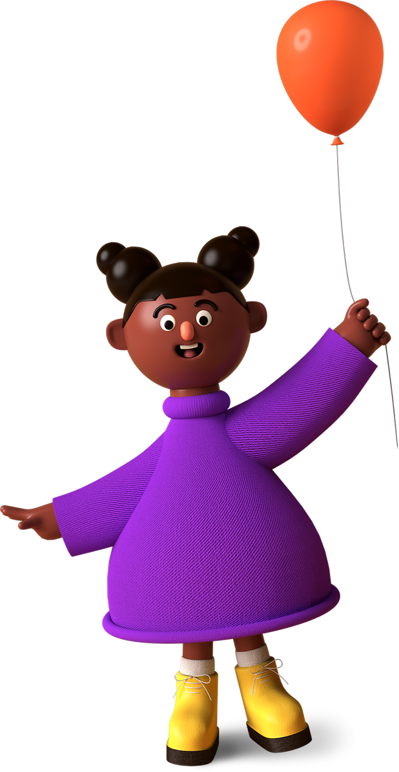
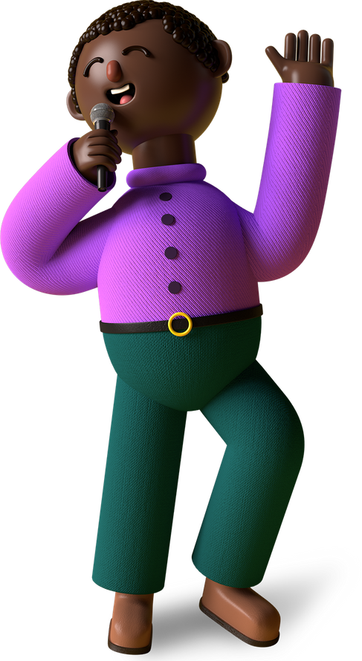
Thank You, Merry X’Mas & A Happy New Year From (YADURAJ.M.K ),
A Young Coder In The Making!

